Slide 1
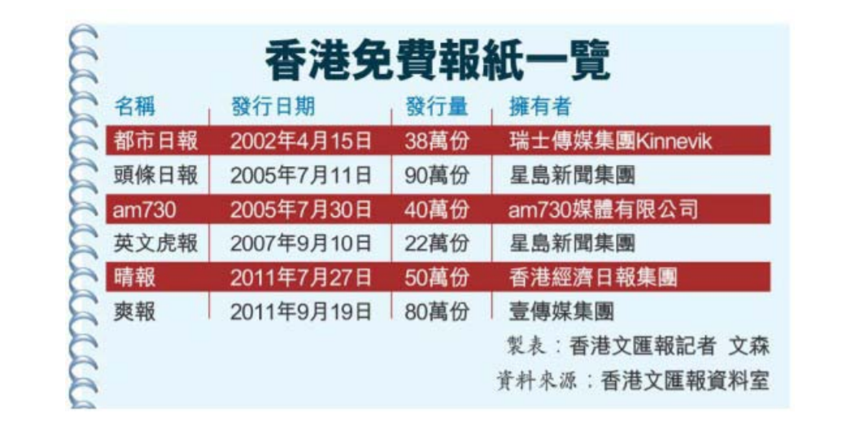
49 newspapers in Hong Kong, and 6 of them are free newspapers.
Source: studies on Development of south China morning post in mainland China

Slide 2
Has Alibaba
Changed
the SCMP?
XU Wen
Yao Nuan
LI Yijie

Slide 3
Content
Story Source
Story Point

Slide 4
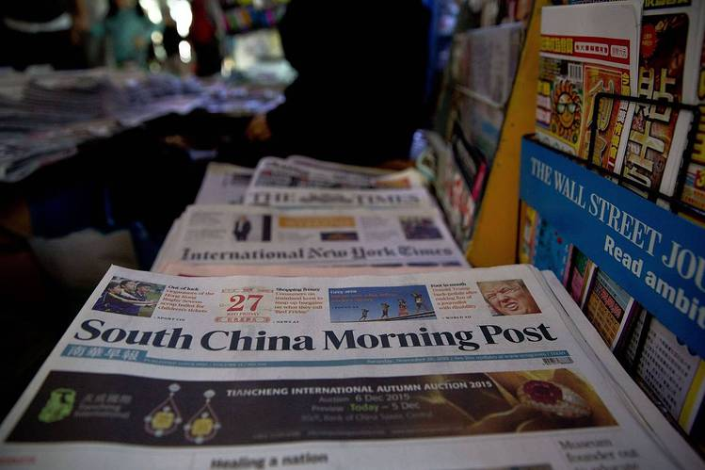
South China Morning Post

Slide 5


Slide 6
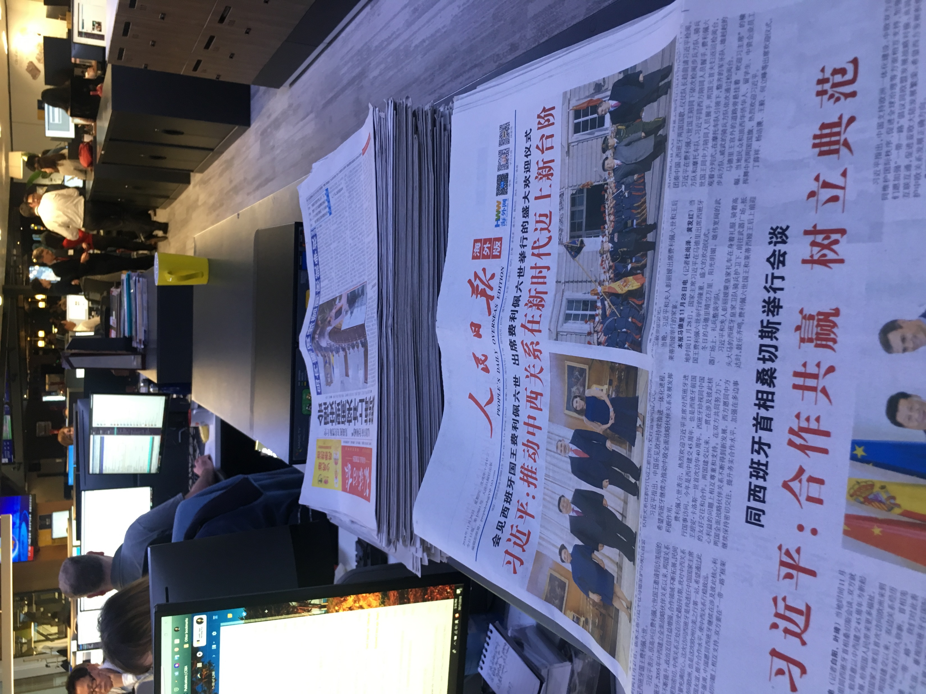
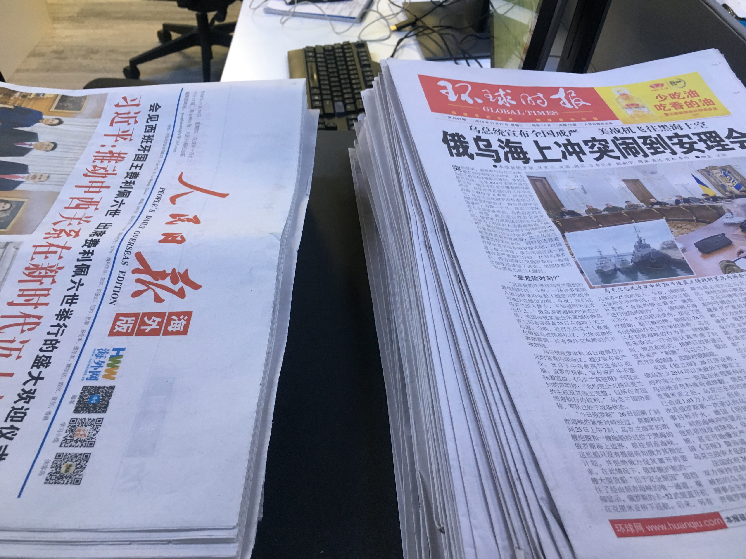
question
Question: Has the content of SCMP changed after Alibaba becoming its parent company?

Slide 7
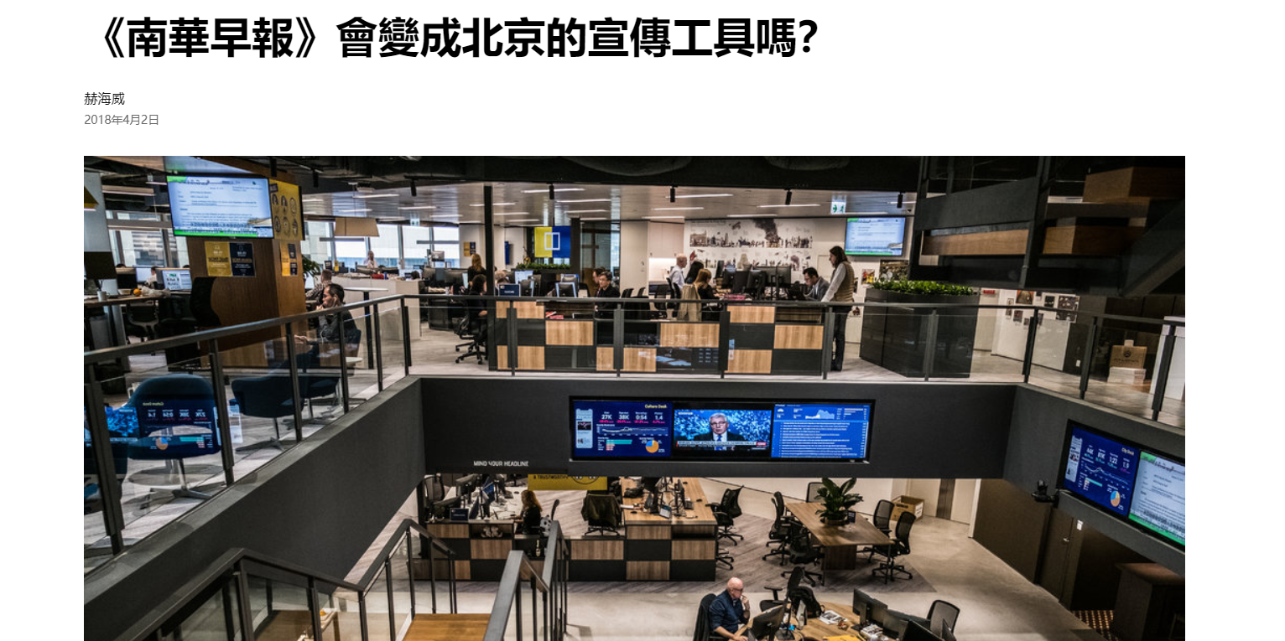
question
Source: New York Times Chinese edition

Slide 8
Story Source-data
Source
Library data from HKBU website:
Publications about SCMP (2010-2018)
Publications about China Daily
Publications about People’s Daily
Data Volume
263,108（SCMP)

Slide 9
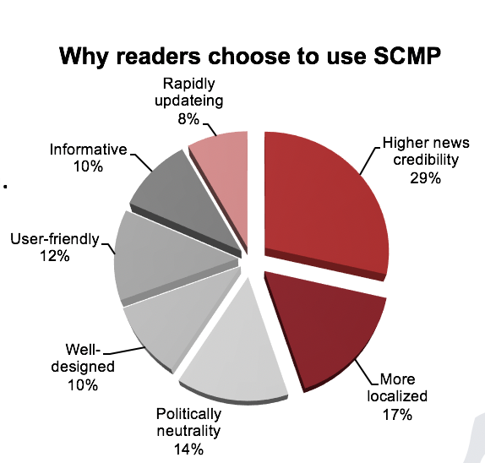
Story Source-people
SCMP Survey Quesionnaire
01
Gray Liu (SCMP CEO)
02
Steve ( Director of MA in Communication, China Daily's journalist
03
Bernice (SCMP Journalist）
04
CK Lau( SCMP former chief editor)
05
source: a group of master students from comm7200 in HKBU, 2018
Annie Zhang ( former chief editor of Initium media)

Slide 10
Story Point

Slide 11
Point
01
02
03
Jack Ma and his company
More news related G20...
Xi Jinping in 2012 and 2018

Slide 12
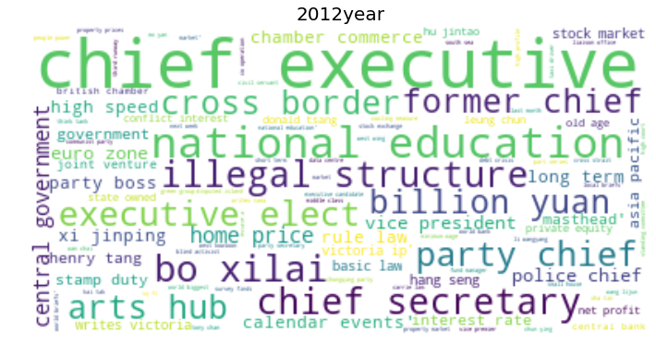
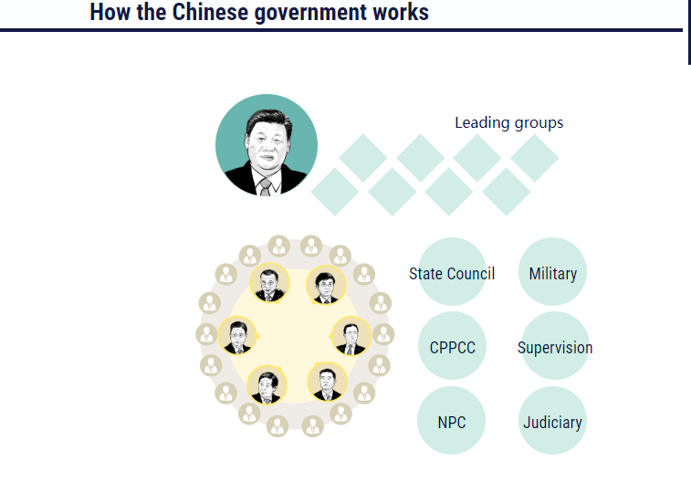
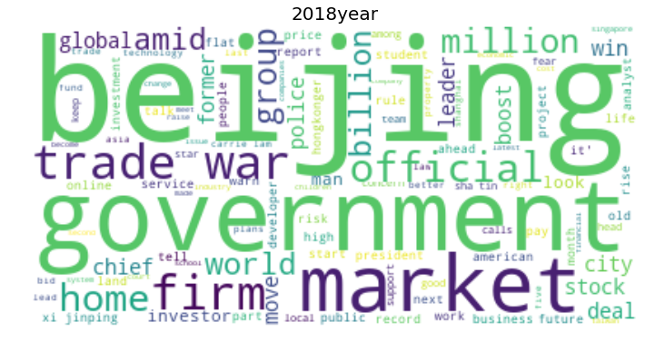
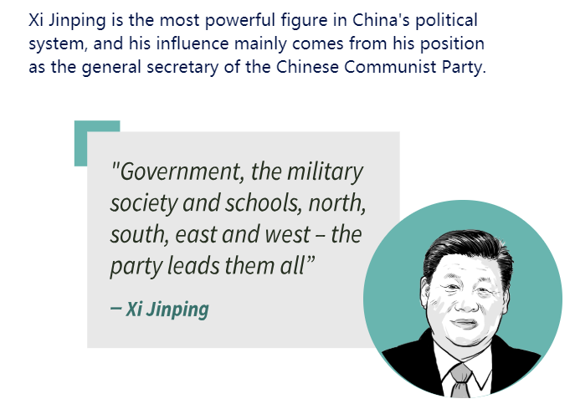
Point
2012
Source: South China Morning Post

Slide 13
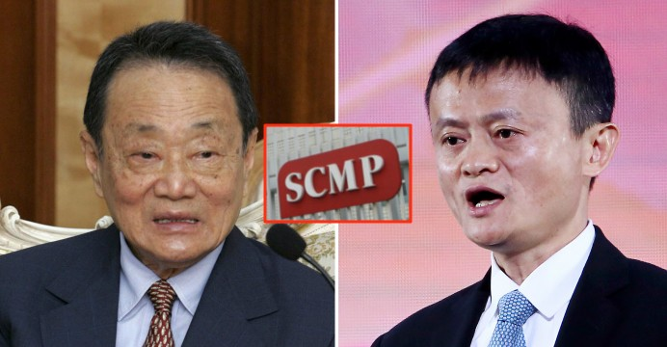
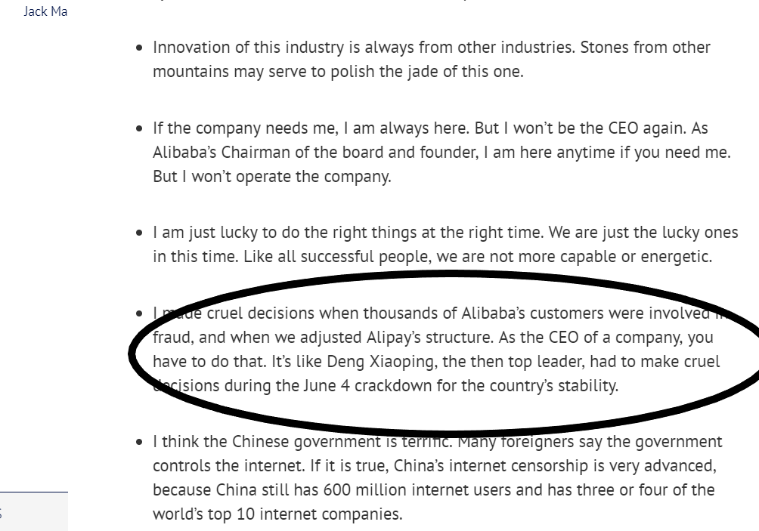
Point
Jack Ma& SCMP
2013 interviewed by Liuyi from SCMP-140,000 weibo fans
2015&2016

Slide 14
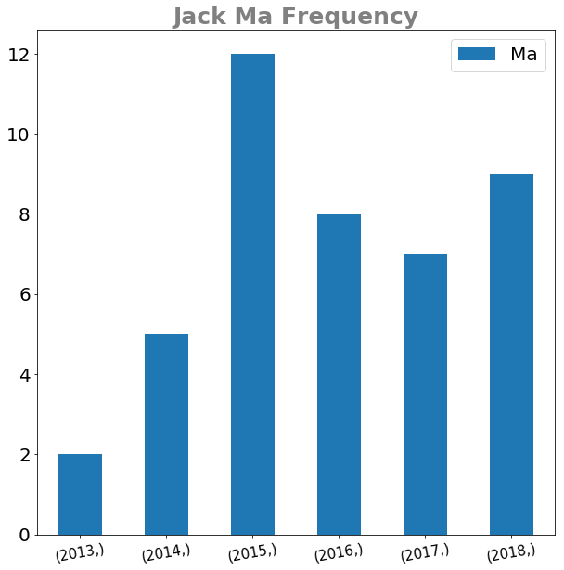
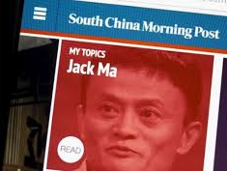
Point

Slide 15
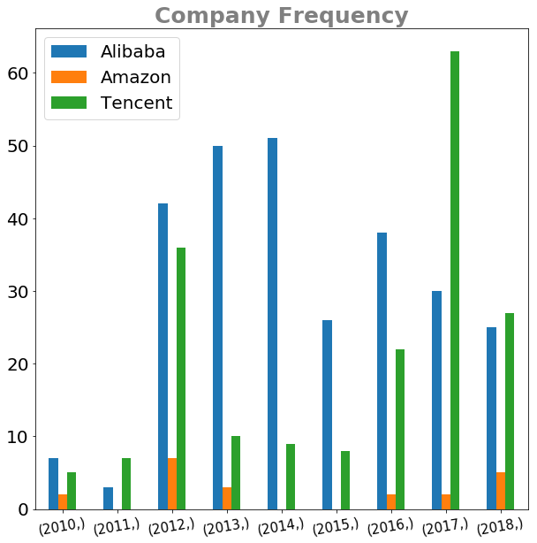
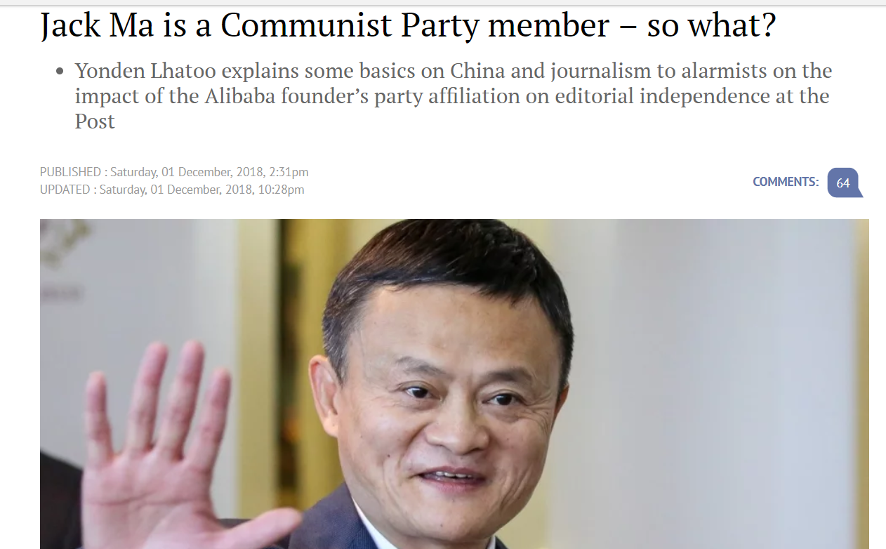
The government is terrific.. ┛

Slide 16
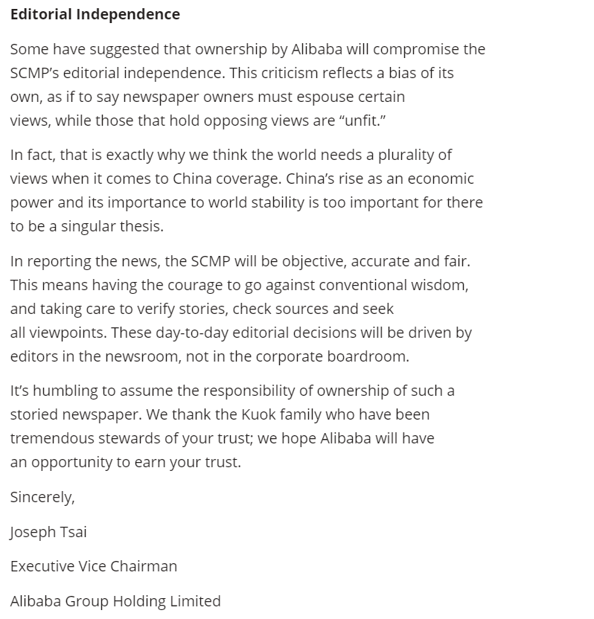
Point
蔡崇信：致《南华早报》读者的一封信
Letter to readers of the South China Morning Post, from Alibaba's executive vice chairman
the portrayal of China in a more positive light is part of the rationale behind Alibaba’s acquisition

Slide 17

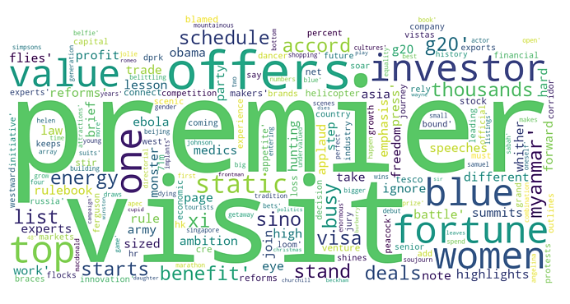
Point
G20 Summit
SCMP G20 word frequency 2015
China Daily G20 word frequency 2014

Slide 18


Point
G20 summit
SCMP 2016 Beijing
SCMP 2017

Slide 19
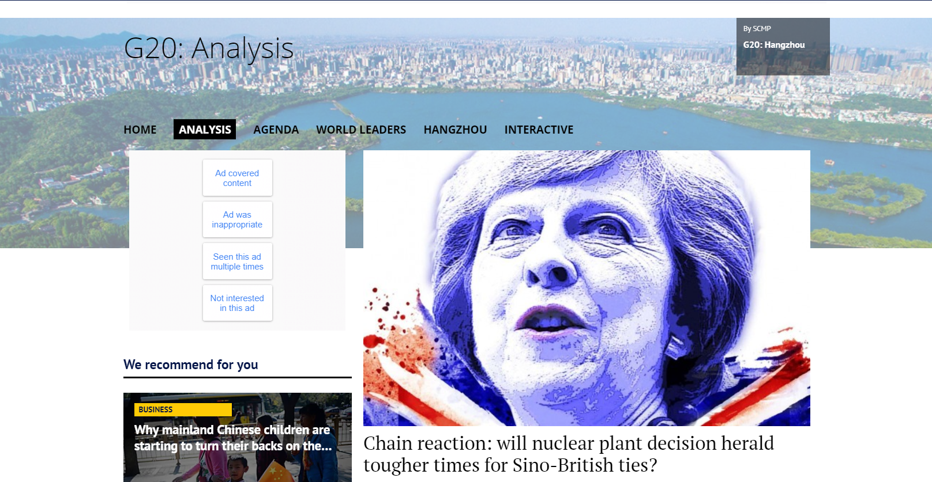
Point
G20 summit

Slide 20
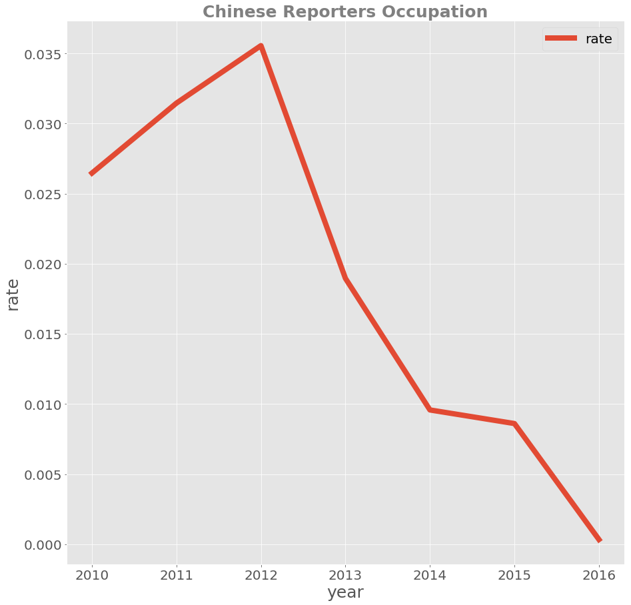
Point
Tendency of numbers of Chinse reporters

Slide 21
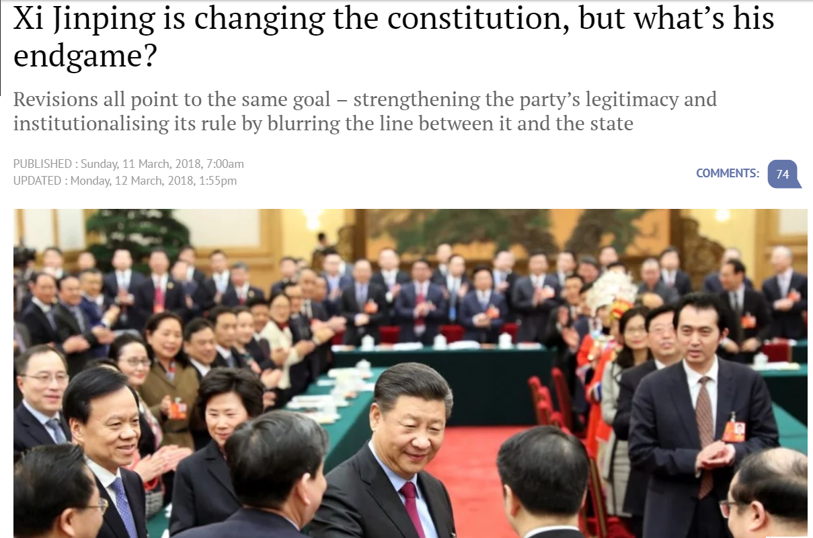
still report those negative events and be critical.
But, the scmp started to have many articles to show the country in a more positive way.

Slide 22
Thanks

